Slide 1

Synthetic Biology Open Language 2.0 Design
UW Synthetic Biology Supergroup Meeting, October 5, 2015
Bryan Bartley (UW), Jacob Beal (Raytheon), Kevin Clancy (ThermoFisher), Goksel Misirli (Newcastle), Nicholas Roehner (BU), Herbert Sauro (UW), & SBOL community

Slide 2
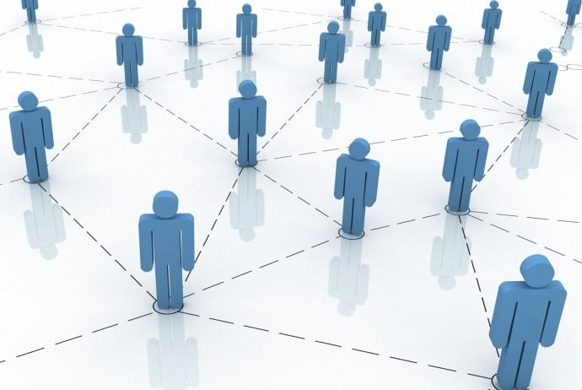
SBOL (pronounced es ·bohl) is derived from the Welsh word pobol for people
Data exchange standards help people collaborate and communicate
The SBOL development process is open and public (sbolstandard.org)

Slide 3


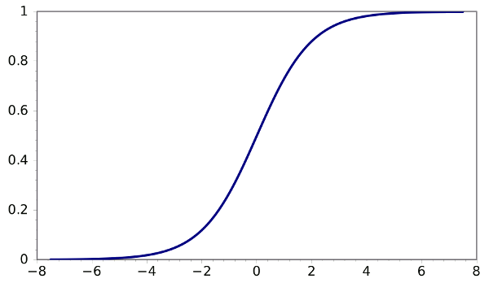




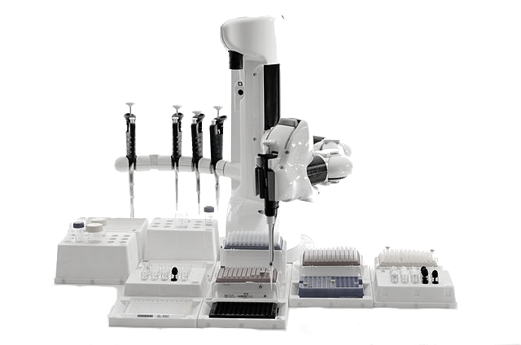
RESOURCES
CAD/Modeling
sbolstandard.org
SBOL documents (RDF/XML format)
open source software libraries (libSBOL)
images, fonts, and webtools
converters
ontologies
Measurement
Sequencing
&
Synthesis
Publication
Repositories & Databases
Automation

Slide 4
EVOLVING STANDARDS
FASTA
GenBank
SBOL 1.1
SBOL 2.0
ACTGTGCCGTTAAACGTGATTAAATCCGTACTGATAT…
TetR
GFP
pTet
aTc detector
GFP reporter
TetR
GFP
pTet
aTc detector
aTc
GFP reporter
TetR
GFP
TetR
GFP
pTet

Slide 5


2.0 OVERVIEW
aTc detector
aTc
GFP reporter
TetR
GFP
TetR
GFP
pTet
Measurement Data
GenBank
Strain Information
Qualitative function
Hierarchical composition
Incomplete designs
Other molecule types
Regulatory architecture
Links to other data

Slide 6

INTER-OPERABLE
SO:
Shine_Dalgarno_sequence
CDS
terminator
SBOL Data Core 1.1, 2.0
SBOL is a standard built on other standards
SBOL components are associated with their icons by their Sequence Ontology term
SBOL is interoperable with several ontologies (eg, BioPAX, ChEBI) used by public bioinformatics resources
SBOL Visual

Slide 7
ONTOLOGIES
Biologists love to classify…
Sequence Ontology is a standardized classification system for categorizing and describing DNA sequences
Look at all the cool things! http://www.sequenceontology.org/browser/obob.cgi
sequence_feature
region
biological_region
Shine_Dalgarno_sequence
CDS
terminator
…
experimental_feature
assembly_component
nucleotide_match
…

Slide 8
em: green
ex: blue
strength: weak
EXTENSIBILE
‘atttaattaa’
‘atg…taa’
‘tcggctattgg’
synthetic biology is a young and evolving field
extensibility promotes new ideas and new ways of looking at data
the core standard is stable and contains the most essential data about genetic designs
over time extensions become core

Slide 9
HIERARCHY

Slide 10
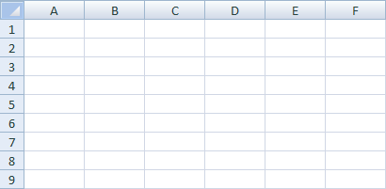


Slide 11

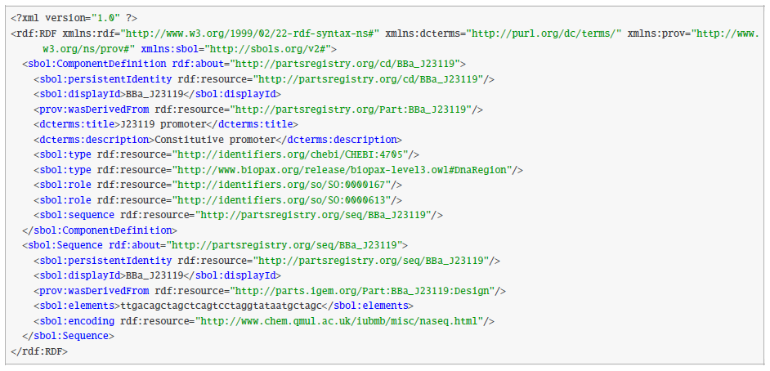

SERIALIZATION
Ignore the fine print
XML allows you to structure data in trees
RDF provides extensibility

Slide 12
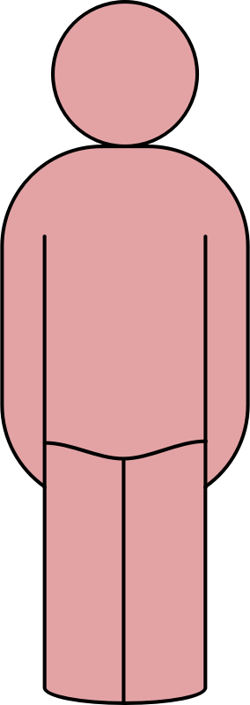

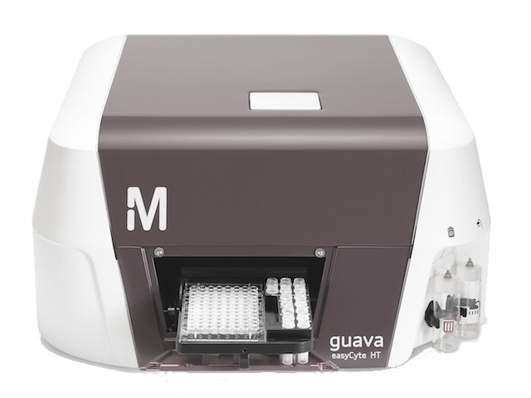

WORKFLOWS
Repositories
User
User
Automation
Vendors

Slide 13
WORKFLOWS
Repositories
User
User
Reuse/Share
Automation
Vendors

Slide 14
WORKFLOWS
Repositories
User
User
Reuse/Share
Visualize
Automation
Vendors

Slide 15
WORKFLOWS
Repositories
User
User
Reuse/Share
Visualize
Design/Model
Automation
Vendors

Slide 16
WORKFLOWS
Repositories
User
User
Reuse/Share
Visualize
Design/Model
Synthesize/Build
Automation
Vendors

Slide 17
WORKFLOWS
Repositories
User
User
Reuse/Share
Visualize
Design/Model
Synthesize/Build
Automate
Automation
Vendors

Slide 18
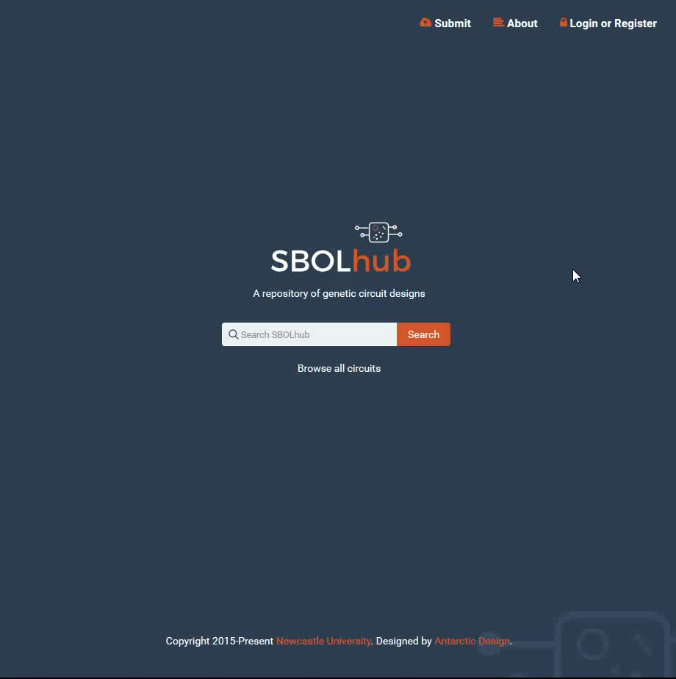

SHARE & REUSE
SBOLhub
Searchable repository for public, private designs
Journal integration for "one-click" private review
Import SBOL/FASTA/GenBank, Export SBOL

Slide 19
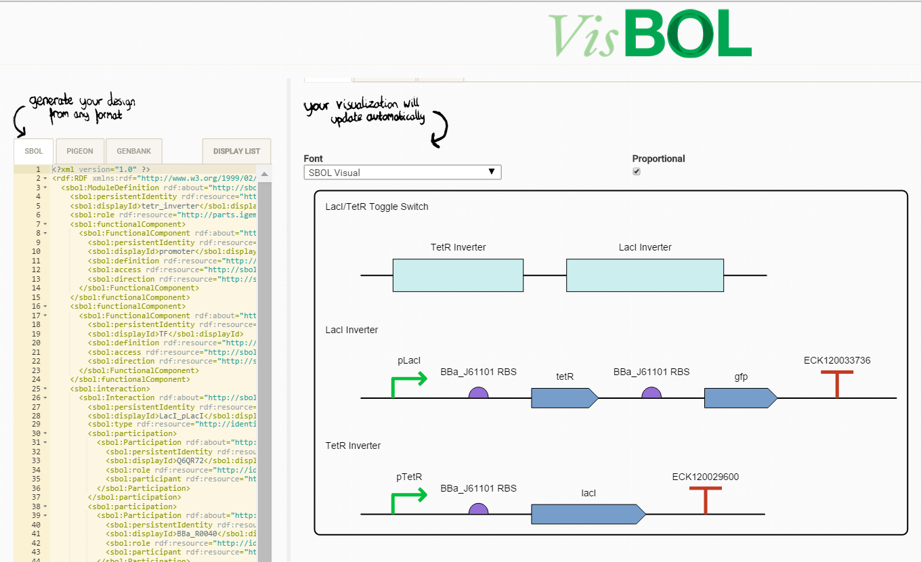
VisBOL
Multiple import formats
Design visualization using SBOL glyphs
VISUALIZE
http://visbol.org/design/

Slide 20
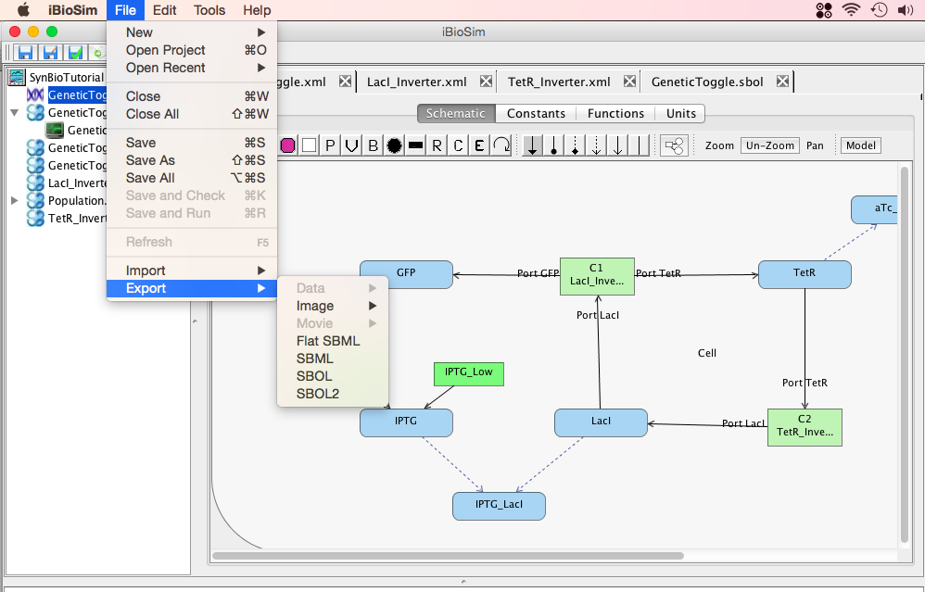

DESIGN & MODEL
iBioSim
Graphical design of reaction networks
Import or export both SBML and SBOL 2.0
Simulate ODE, SSA
www.async.ece.utah.edu/iBioSim/

Slide 21
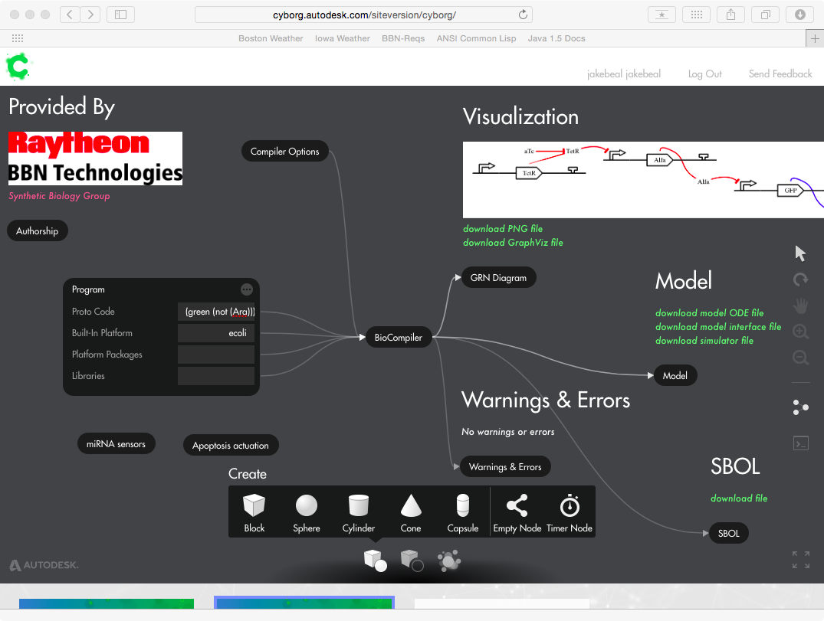

DESIGN & MODEL
BioCompiler
Generate GRN design from functional program
SBOL visualization and design output
ODE simulations
https://synbiotools.bbn.com/

Slide 22
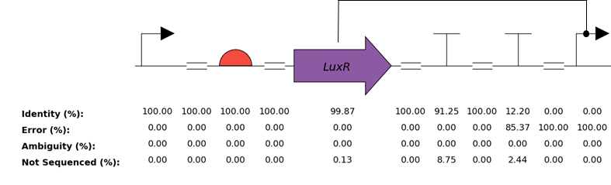


AUTOMATE
DNAplotlib
Python package for creating custom figures
SBOL import/export
Automated sequence analysis and QC
https://github.com/SynBioDex/dnaplotlib

Slide 23
JBEI
ACS Syn Bio
Seelig Lab
iGEM Registry
Lidstrom Lab
publish
design
Dunham Lab
push genetic
parts to repo
Klavins Lab
share strains
Sauro Lab
send measurement data
share strains
get parts from repo
Carothers Lab
send QC report
share sequencing data

Slide 24

BEYOND 2.0
SBOL still has a rather narrow concept of “design” …what other designs can you imagine?
What kind of data are you keeping in spreadsheets?
How should biological knowledge be organized and classified?
What are the connections between different fields of knowledge(eg, systems & synthetic biology)?

Slide 25
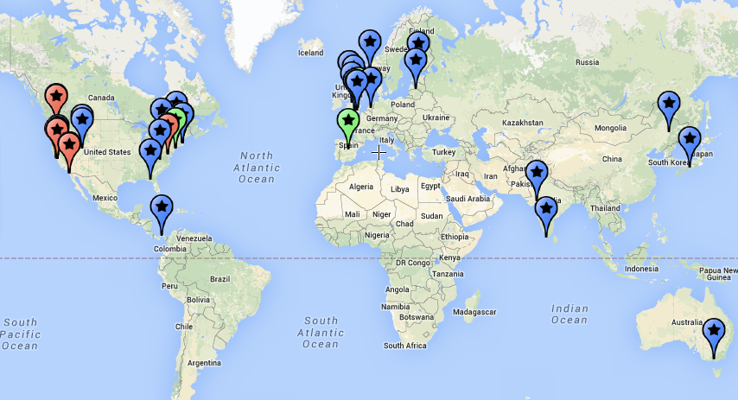


JOIN!
100+ people from all around the world
30 universities, 14 companies, 8 others
Ongoing development starting 2008
Major
funders:
Notes:
Community has: more than 100 people, representing 30 universities, 14 companies, 8 other institutions

Slide 26
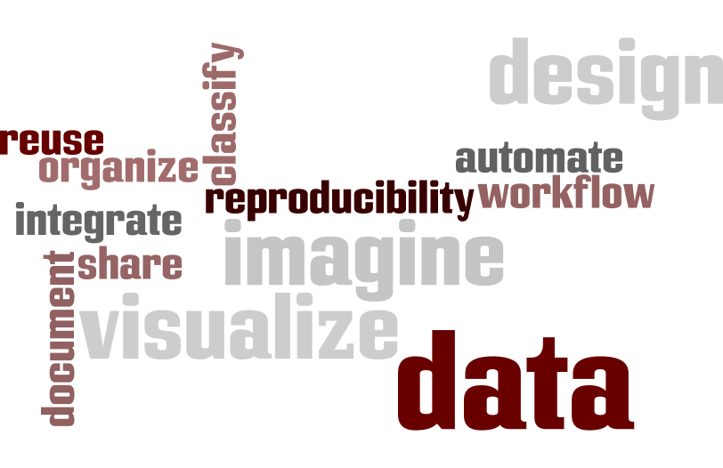
Call to Action!
visualize
document
work efficiently
automate
organize
think about
design
share
integrate
reproduce someone else’s work
imagine
http://sbolstandard.org/

